Slide 1

Banking Simplified:
A “C” Programming Approach
Innovative Account Management at Your Fingertips
1

Slide 2
Introduction
Project Overview
Features
C-based console application for
managing bank accounts.
Load and save accounts from files.
Secure transactions with PIN verification.
Simplifies banking operations.
Search, update, and manage account information.
2

Slide 3

Team Contribution Summary
Md. Shahraj Mashrafe
Mashfe
ID: C243217
Raihan Islam
ID: C243212
saveAccountsToFile
updateBalance
createAccount
verifyPIN
Susmoy Chakraborty
ID: C243245
Obaidur Rahim
ID: C243228
displayAccounts
searchAccount
loadAccounts
copyOutputToAccounts
3

Slide 4
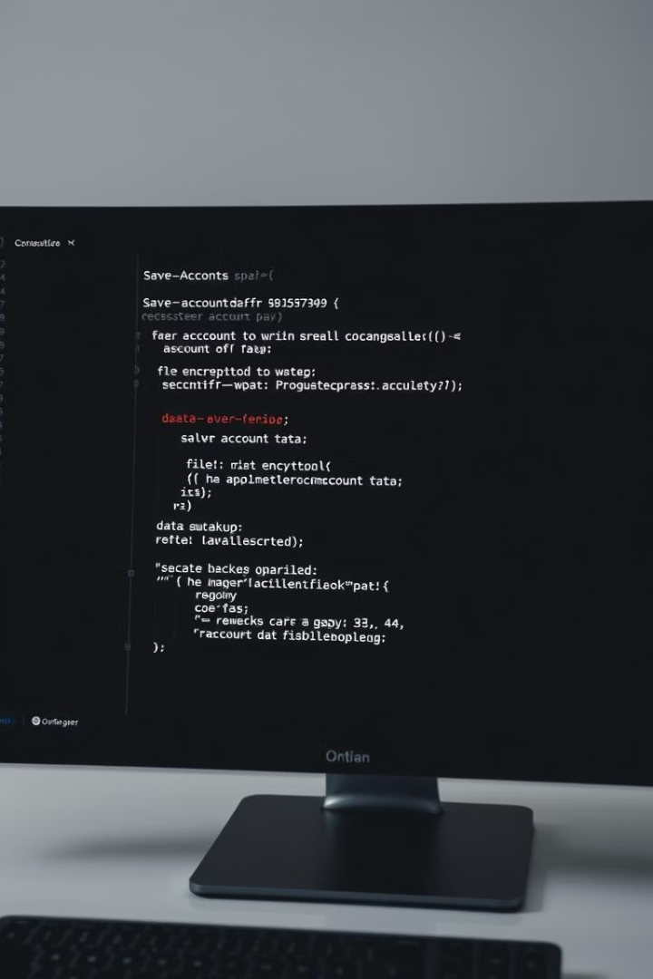
Function-1:
saveAccountsToFile
1
Purpose
2
Work
Saves account data to a file.
Writes updated account details to Output.txt.
Ensures data persistence.
3
Improvements
Encrypt sensitive data.
Add options for backup files.
4

Slide 5
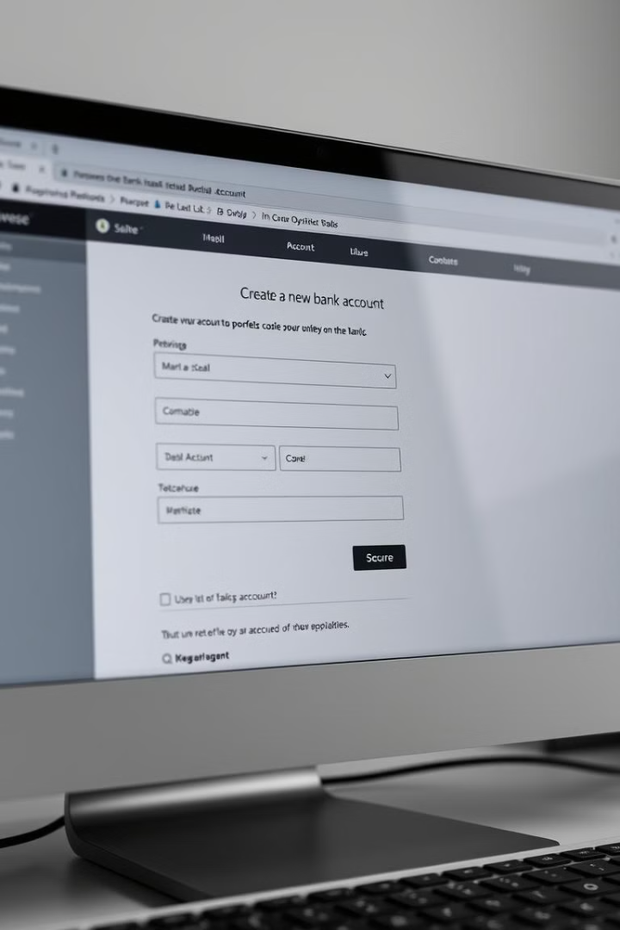
Function-2:
createAccount
1
Purpose
2
Work
Creates a new account.
Takes user inputs for account details.
Validates account number uniqueness and PIN format.
3
Improvements
Lets user give their own account numbers which is unique
to others.
Add email/phone input.
5

Slide 6
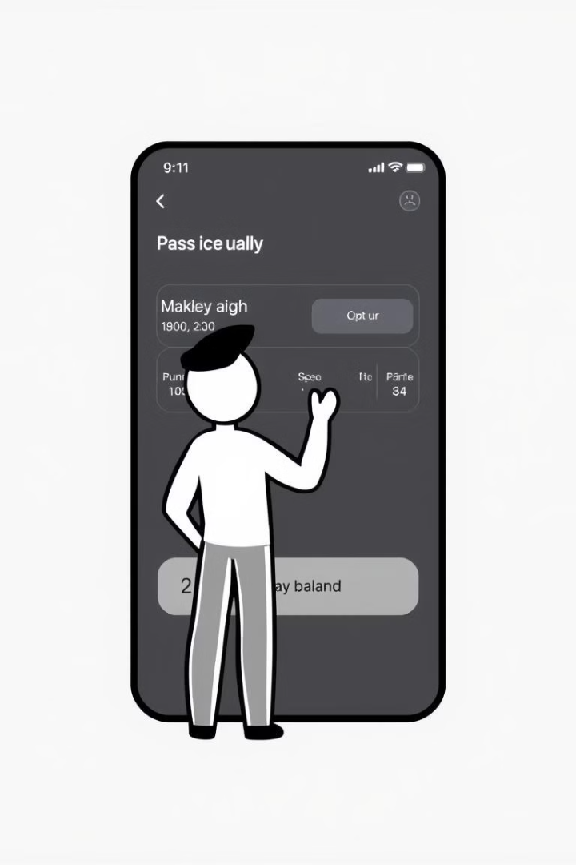
Function-3:
updateBalance
1
Purpose
2
Work
Handles deposit or withdrawal transactions.
Verifies the account PIN.
Updates balance after validating sufficient funds.
3
Improvements
Add transaction history.
Support multiple transactions in one session.
6

Slide 7

Function-4:
verifyPIN
1
Purpose
2
Work
3
Improvements
Ensures secure access by verifying a user's PIN.
Compares user-entered PIN with stored PIN.
Introduce multi-factor authentication.
Grants or denies access based on match.
Lock account after multiple incorrect attempts.
7

Slide 8
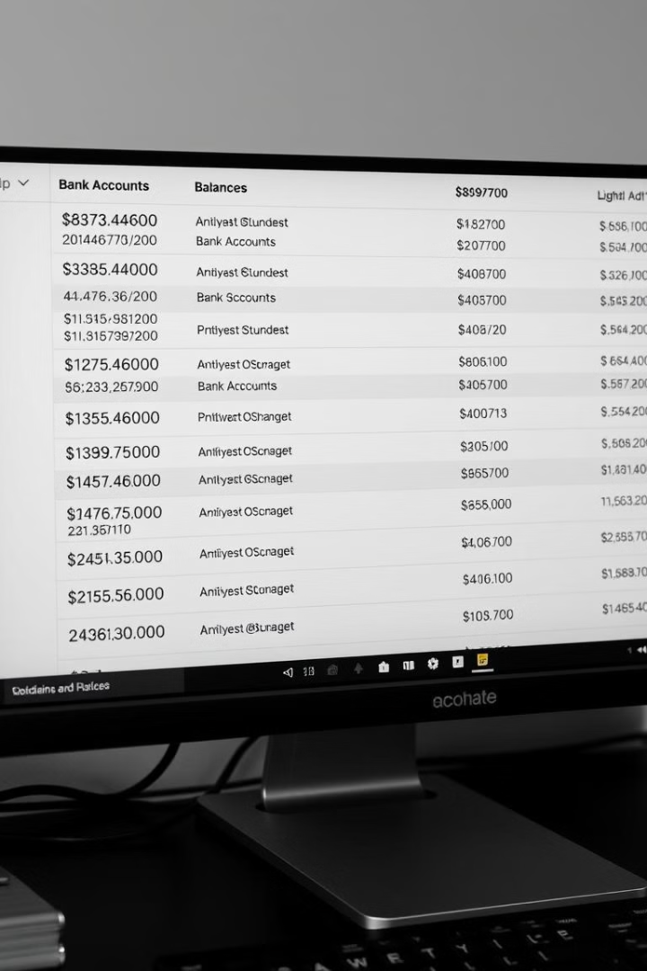
Function-5:
displayAccounts
1
Purpose
2
Work
Displays all existing accounts.
Lists account details.
Skips displaying sensitive information(Pin Number).
3
Improvements
Add sorting options.
Include account creation date.
8

Slide 9

Function-6:
loadAccounts
1
Purpose
2
Work
3
Improvements
Loads account data from a file.
Reads account details from Accounts.txt.
Add error handling for file corruption.
Displays total accounts loaded.
Support loading from multiple file formats.
9

Slide 10
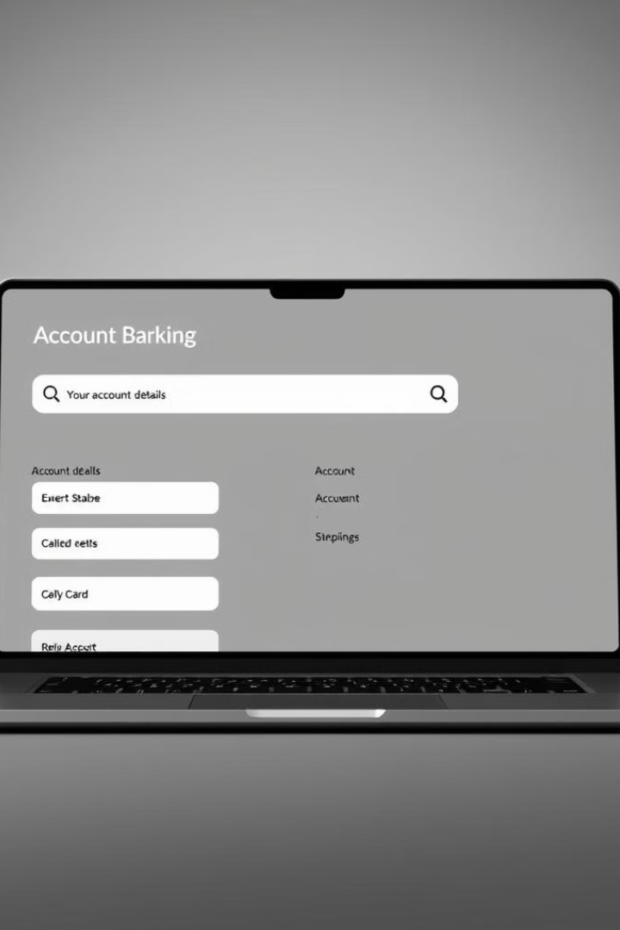
Function-7:
searchAccount
1
Purpose
2
Work
Finds and displays account details.
Searches by account number.
Verifies PIN before displaying details.
3
Improvements
Enable search by name or other attributes.
Allow partial searches.
10

Slide 11
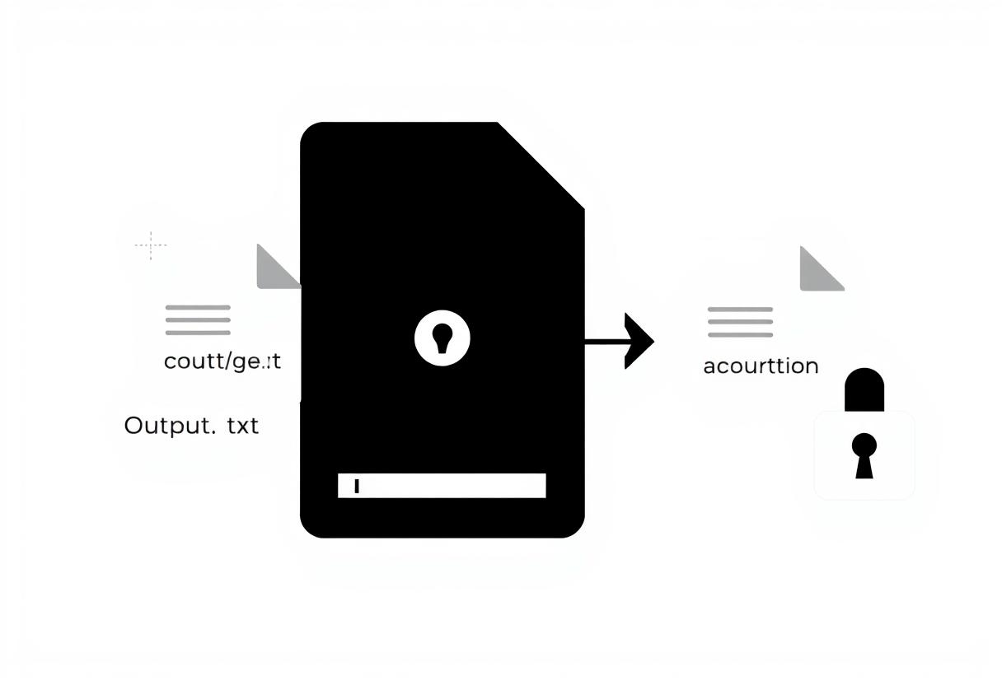
Function-8:
copyOutputToAccounts
1
Purpose
2
Work
3
Improvements
Copies updated account data from Output.txt to Accounts.txt, ensuring data consistency.
Overwrites Accounts.txt with data from Output.txt, then deletes Output.txt.
Add error handling, logging, and consider atomic operations for robust file transfer.
11

Slide 12
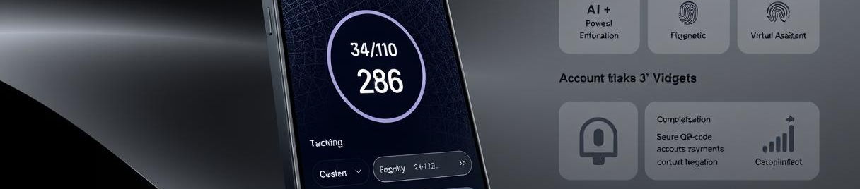
Next Steps for Improvement
1
Money Transfer
2
View Bank-Statement
Lets user Transfer money to other Accounts.
Allows users to access transaction details through verification.
3
Real-Time Notifications
4
Advanced Search and Filtering
Develop a system to send SMS or email notifications for every transaction.
Implement search filters based on multiple parameters like name, balance range, or account type.
12

Slide 13

Thank you for your time!
We hope this presentation provided valuable insights.

